Slide 1
Figures-Chapter 2

Slide 2
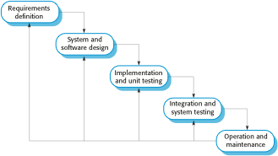
Figure 2.1 The waterfall model

Slide 3
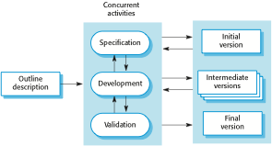
Figure 2.2 Incremental development

Slide 4

Figure 2.3 Reuse-oriented software engineering

Slide 5
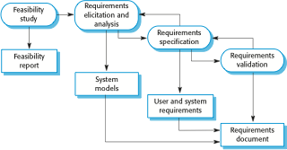
Figure 2.4 The requirements engineering process

Slide 6
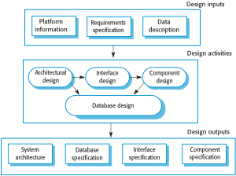
Figure 2.5 A general model of the design process

Slide 7

Figure 2.6 Stages of testing

Slide 8
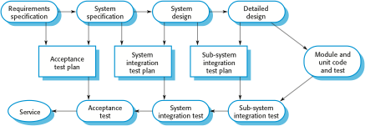
Figure 2.7 Testing phases in a plan-driven software process

Slide 9

Figure 2.8 System evolution

Slide 10

Figure 2.9 The process of prototype development

Slide 11
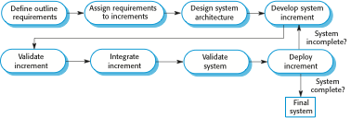
Figure 2.10 Incremental delivery

Slide 12
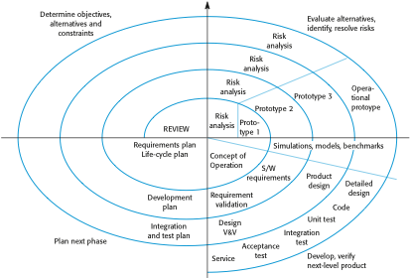
Figure 2.11 Boehm’s spiral model of the software process

Slide 13
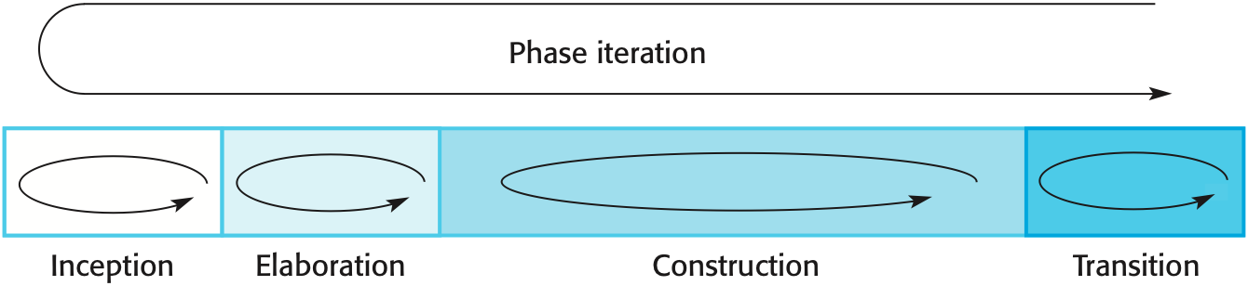
Figure 2.12 Phases in the Rational Unified Process

Slide 14
Figure 2.13 Static workflows in the Rational Unified Process
Workflow | Description
Business modelling | The business processes are modelled using business use cases.
Requirements | Actors who interact with the system are identified and use cases are developed to model the system requirements.
Analysis and design | A design model is created and documented using architectural models, component models, object models and sequence models.
Implementation | The components in the system are implemented and structured into implementation sub-systems. Automatic code generation from design models helps accelerate this process.
Testing | Testing is an iterative process that is carried out in conjunction with implementation. System testing follows the completion of the implementation.
Deployment | A product release is created, distributed to users and installed in their workplace.
Configuration and change management | This supporting workflow managed changes to the system (see Chapter 25).
Project management | This supporting workflow manages the system development (see Chapters 22 and 23).
Environment | This workflow is concerned with making appropriate software tools available to the software development team.

